Slide 1
The User Interface Architecture
October 17, 2014
Notes:
Guidewire training materials contain Guidewire proprietary information that is subject to confidentiality and non-disclosure agreements. You agree to use the information in this manual solely for the purpose of training to implement Guidewire software solutions. You also agree not to disclose the information in this manual to third parties or copy this manual without prior written consent from Guidewire. Guidewire training may be given only by Guidewire employees or certified Guidewire partners under the appropriate agreement with Guidewire.
1

Slide 2
User interface architecture
PCF files
Create and open PCF files
Modify PCF files
Deploy PCF files
Notes:
2

Slide 3
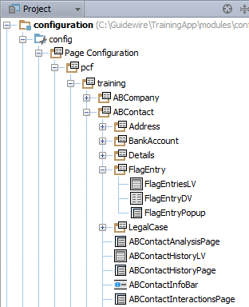
Project view
PCF folders
Group PCF files and folders
PCF files
Container widgets
Locations
PCF file suffix examples:
DV – detail view panel
LV – list view panel
InputSet – input set
CV – card view panel
LDV – list detail panel
Screen – screen
LG – location group
Wizard – wizard
Notes:
Any PCF file in any folder can reference content in another PCF file in any other PCF folder. Developers often logically group related PCF files in PCF Folders.
Guidewire recommends that suffixes be used with PCF file names to indicate the contents of the file. In some cases, the suffix is required. If you create the PCF using Guidewire Studio, Studio will automatically append the file suffix for you.
Common suffixes include:
DV – detail view panel (detail view)
LV – list view panel (list view)
InputSet – input set
CV – card view panel (card view)
LDV – list detail panel (list-detail view)
Screen – screen
LG – location group
Wizard – wizard
3

Slide 4
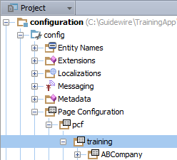
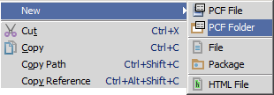
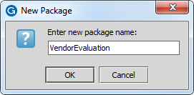
Optionally create a PCF Folder
In Project View, select a PCF Folder in ...\config\Page Configuration\pcf\
Context menu → New → PCF Folder
Specify folder name in New Package dialog
Notes:
PCF Folders organize PCF files. Consider organizing PCF Files into PCF Folders.
In the physical folders for the application, there is no Page Configuration Folder. The physical folder is "web". The Page Configuration Folder in the Project View is an alias for the physical web folder in the file system.
4

Slide 5
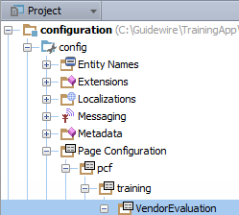
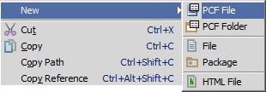
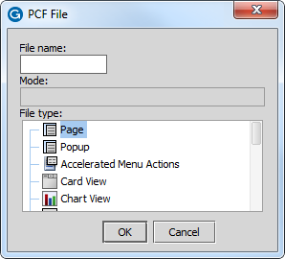
Create a PCF File (1)
In Project View, select a PCF Folder in …\config\ Page Configuration\pcf\
Context menu → New → PCF File
Opens PCF File dialog
Notes:
5

Slide 6
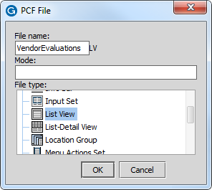
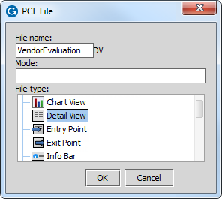
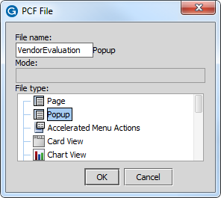
Create a PCF File (2)
PCF File dialog appends suffix in most cases
File name + File Type selection
Adds suffix to File Name
Examples
VendorEvaluationsLV, VendorEvaluationDV, VendorEvaluationPopup
Notes:
Specify the name of the file in the dialog and the file type. The dialog automatically appends the suffix to the file name when necessary.
6

Slide 7


Open a PCF in Studio
CTRL+N
Find Class…
CTRL+SHIFT+N
Find File…
Notes:
7

Slide 8
User interface architecture
PCF files
Create and open PCF files
Modify PCF files
Deploy PCF files
Notes:
8

Slide 9
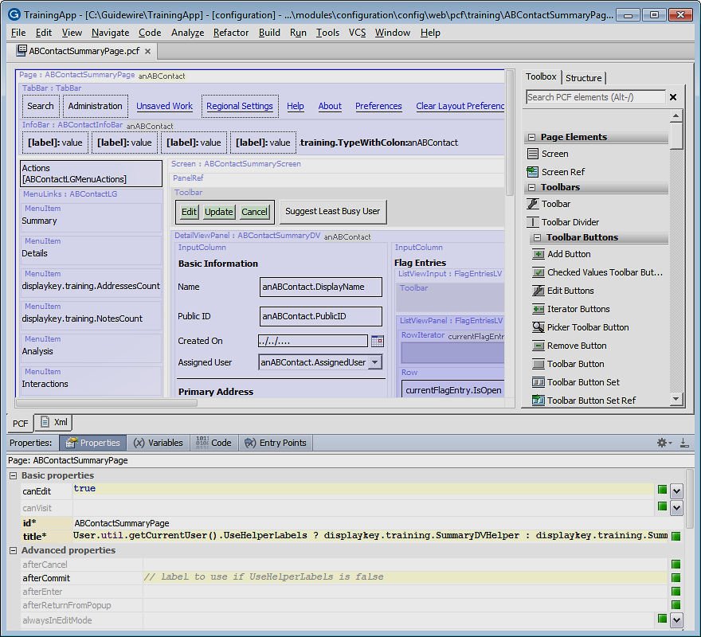
Page Configuration (PCF) editor
View and edit page configuration files (PCF)
…\config\web\pcf\
View file as read-only XML
Consists of
PCF canvas
Toolbox tab
Structure tab
Properties Window
Notes:
Guidewire applications use a page configuration format (PCF) files to render the application user interface. Use the Page Configuration File (PCF) editor to edit PCF files. The PCF Editor supports drag-and-drop composition of PCF pages using graphical elements, PCF page grouping views, Gosu code, display key creation, and much more.
9

Slide 10
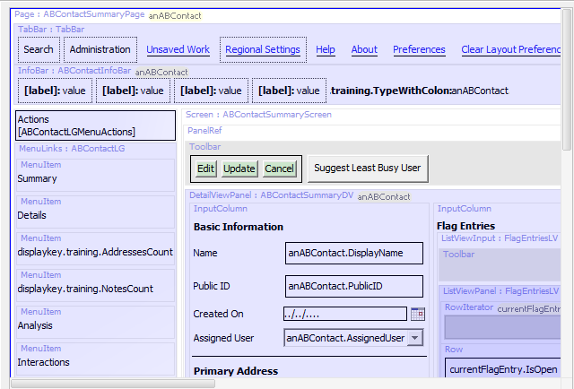
PCF editor: Canvas
Graphical representation of PCF elements (widgets):
Content
Container
Gosu symbol
Conditionally visible
Iterator
RowIterator
Colors
Hierarchy
Warnings
Placement
Supports drag-and-drop from toolbox
Context menu commands
Notes:
The PCF editor contains a canvas that provides a gthephic display of the contents of the file. From the canvas, you can select an item to display and edit its properties. You can also move and delete existing items. In addition, the canvas in the Studio center pane provides a drag-and-drop capability for working with the PCF elements (widgets) on the PCF page. On the canvas, Studio displays:
Elements that represent actual screen content (inputs, and similar items) as a simplified version of how they appear within ClaimCenter.
Elements that function primarily as containers (data view panels, for example) as light gray boxes, with a header indicating the element type and ID.
Elements that define or expose additional Gosu symbols to their descendants as light gray boxes, with a list of symbols at the top. If you move your mouse over a symbol, Studio shows a tooltip with the name, type, and initial value of the symbol.
If the symbol represents a Require, the tooltip indicates this as well.
If you click a symbol name, Studio selects the containing element, and then opens the appropriate properties tab for editing whatever is providing the symbol. Finally, if necessary, Studio selects the symbol in the Properties tab.
Elements that are conditionally visible with a dotted border.
Elements that iterate over a set of data and produce their contents once for each element in the data by a single copy of the contents. It follows this with an ellipsis to indicate iteration.
RowIterator widgets with inferred header and footer cells in the position in which they appear.
The Canvas also allows for you to view all the nested elements. Files can be nested as deep as necessary, in which case the color of the shaded area will be progressively deeper, for example:
White - defined in this file
Light blue -defined in other file that is referenced by this file
Dark blue - defined in file referenced by referenced file
Double-clicking at any level will open the selected PCF directly.
10

Slide 11
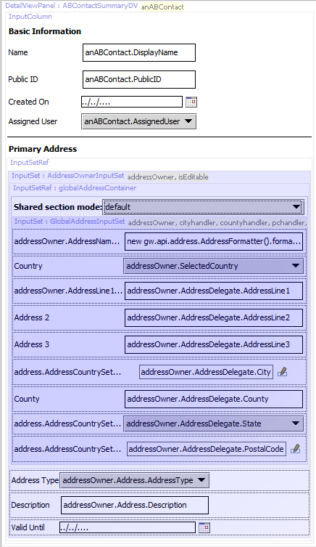
Included sections
White
In this file
Light purple
Reference to another file
Darker purple
Reference to a file that includes another reference to a file
Color darkens with additional nesting of included sections
Notes:
Files can be nested as deep as necessary, in which case the color of the shaded area will be progressively deeper. Double-clicking at any level will open the selected file directly. You can toggle the visibility of child files embedded in a parent PCF file. If you disable the representation of the included files, Studio displays the text of the reference expression instead.
11

Slide 12
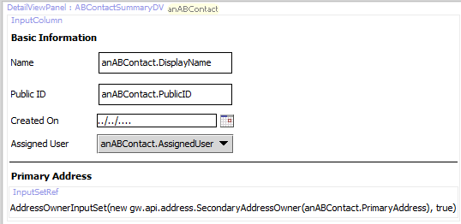
Show / Hide included sections
Toggle the visibility with PCF canvas context menu command
Hide included sections
Show included sections
Hide
Show
Notes:
Show/Hide included sections: Toggle the visibility of child files embedded in a parent PCF file. If you disable the representation of the included files, Studio displays the text of the reference expression instead.
12

Slide 13
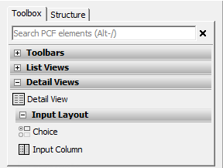
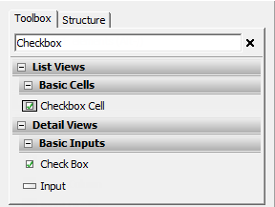
PCF Editor: Toolbox
Categories
Search box
Expand and collapse
Categories
Subcategories
Matches results by
Category name
Widget description or name
Xml element name
ALT+/ keystroke
Notes:
The Toolbox tab is a list of widgets. To add elements to a PCF file, you select the corresponding tool in the toolbox and drag it onto the canvas. The Toolbox tab contains a search box and a list widgets organized into specific categories and subcategories.
Clicking on a category name expands or collapses that category. Clicking on a subcategory name expands or collapses that subcategory as well. Guidewire Studio only displays widget categories containing widgets that are valid and available for use in the current PCF file. Guidewire Studio displays a description of that widget in a tooltip when you hover over the widget with your mouse.
You use the search box to filter the full set of widgets. As you type a search term into the search box, the toolbox filters the results by:
Any widgets whose category name matches the typed text
Any widgets whose name matches the typed text
Any widgets whose actual name in the XML matches the typed text
Any widgets whose description contains the typed text
Clicking the X icon by the search box clears text from the box and stops filtering the widget list. Keyboard shortcut ALT+/ gives focus to the search box.
13

Slide 14
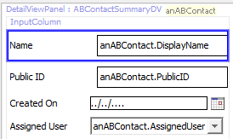
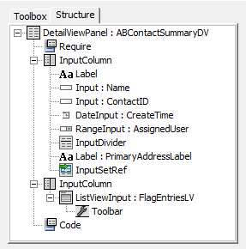
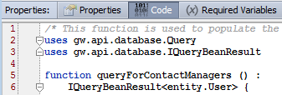
PCF Editor: Structure tab
Shows hierarchal structure of PCF file of elements
Concrete element highlighted in canvas
Non-concrete selects parent element in canvas and opens Properties Window related tab
Notes:
The Structure tab shows the hierarchical structure of the PCF file as a tree. Each node in the tree represents a PCF element. Any children of the node are children of that element.
If you click an element that represents a concrete element on the canvas, Studio selects that element on the canvas.
If you click on an element that does not represent a concrete element on the canvas, then Studio first selects the containing element on the canvas. It then selects the appropriate properties tab with which to edit the clicked element. Finally, if necessary, Studio selects the clicked element in the properties tab (at the bottom of the screen).
14

Slide 15
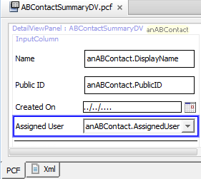
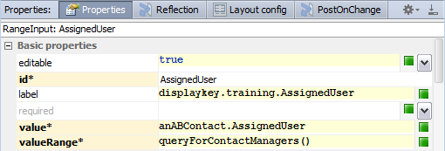
PCF Editor: Properties Window
Select element in
Structure tab or canvas
View and/or edit element properties
Schema aware tabs
Property validation
Notes:
All PCF elements have definable properties in the Properties window. To view properties of a PCF file, click its title link in the upper-left corner. To view properties of any element, click that element.
The Properties window contains multiple property tabs. Click a tab to edit the associated properties. Some properties are not editable. Other properties are required. Required properties have an asterisk and the property name appears against a yellow background.
If you select a property, variable, or entry point, an "X" icon appears on the right-hand side of the cell for that property, variable, or entry point. You can click the "X" to restore the selected property, variable, or entry point to its default value.
The Properties window validates each property expression and/or and value.
15

Slide 16
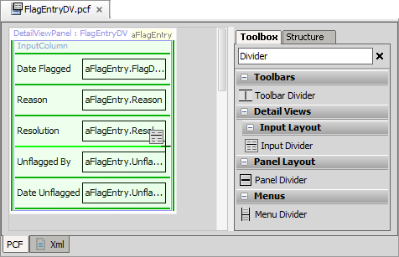
Adding PCF elements
Light green line - new widget will be placed here
Dark green line - new widget could be placed here
Notes:
To add a new widget to a PCF file, select the appropriate tool from the toolbox and drag the widget onto the canvas. As soon as you drag onto the canvas, a series of green lines appear.
Dark green lines indicate places where the widget can legally be placed. A single light green line indicates the place where the widget will be placed if you release the mouse.
16

Slide 17
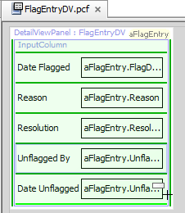
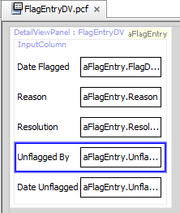
Moving PCF elements
Select element to move and drag to valid location
Light green line - new widget will be placed here
Dark green line - new widget could be placed here
Notes:
Dark green lines indicate places where the widget can legally be placed. A single light green line indicates the place where the widget will be placed if you release the mouse.
17

Slide 18
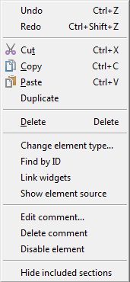
Element context menu commands
Standard editing commands
Change element type…
Opens dialog of possible substitutes
Find by ID
Opens dialog to available elements
Link widgets
Create explicit iterator references
Show element source
Opens window with read-only XML
Edit comment… / Delete Comment
Disable element
Show/Hide included sections
Notes:
The canvas element context menu has many menu actions as explained below:
Enable element: Enable a previously disabled element. This action removes the surrounding comment tags from the element.
Disable element: Disable an element by commenting out the widget. This prevents ClaimCenter from rendering the widget in the interface.
Delete comment: Remove a comment from an element.
Edit comment...:Attach a comment to any element on the canvas
Link widgets: Link widgets on a parent page that spans multiple child PCF files. You use this particularly for explicit iterator references.
Show/Hide included sections: Toggle the visibility of child files embedded in a parent PCF file. If you disable the representation of the included files, Studio displays the text of the reference expression instead.
Show element source: View the XML code for an element. Studio displays the XML code in a pop-up window.
Find by ID: Find an element by its ID. The dialog contains a filter text field. The dialog lists all elements on the canvas that have their id attribute set.
18

Slide 19

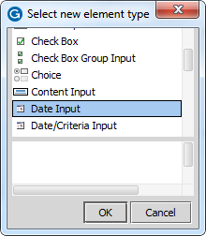
Change element type
Select widget element in canvass
Right click to open context menu
Change element type…
Opens dialog of possible substitutes
Make change selection in dialog
Notes:
"Change element type…" context menu command substitutes a different element for the selected element. The dialog contains a list of element types that you can substitute for the selected element within the constraints of the PCF schema.
19

Slide 20
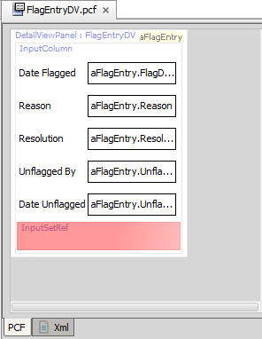

Error messaging
Editor red highlights the widget element with an error
Misconfiguration
Missing configuration
Mouse over element to see Error Message
Notes:
The PCF editor canvas highlights elements with errors.
20

Slide 21

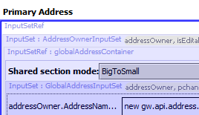
Refresh PCF
Refresh the display of the current PCF file
Main toolbar → Refresh PCF
Helps with widgets that include another widget by reference
Examples
InputSetRef
PanelRef
ScreenRef
Notes:
When you add a PCF widget or edit a PCF widget that includes by reference another widget, you can Refresh the PCF to display the referenced widget.
21

Slide 22
User interface architecture
PCF files
Create and open PCF files
Modify PCF files
Deploy PCFs
Notes:
22

Slide 23
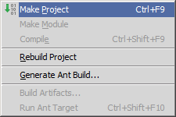
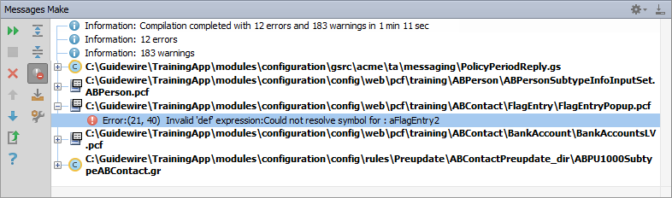
Make project to see all PCF errors
Build → Make Project
Compiles only modified files since the last compilation
Opens Messages (Make) window for build summary
Filter for errors
Great way to see all PCF errors
Notes:
Make Project: All the source files in the entire project that have been modified since the last compilation are compiled. Dependent source files, if appropriate, are also compiled. Additionally, the tasks tied to the compilation or make process on modified sources are performed.
23

Slide 24
Deploy PCFs
Restart Server
Reload PCFs
PCFs read at server startup
ALT+SHIFT+L
Internal debug tools enabled
Internal Tools
Reload → Reload PCF Files
Page Configuration File
Page Configuration File
Notes:
It is also possible to reload PCF files using the Guidewire API and/or internal server tools. The Reload PCF command can be found on the Reload page in Internal Tools. To access Internal Tools, the EnableInternalDebugTools setting in the config.xml file must be set to true. The keystroke to open the Internal Tools page is ALT+SHIFT+T. In the tab bar, select Internal Tools --> Reload. On the Reload page, click the Reload PCF Files button. Both the keystroke ALT+SHIFT+L and the Reload PCF Files button call the same static method: gw.api.tools.InternalToolsUtil.reloadPCFs().
24

Slide 25
Define the broad purpose for each element category:
Atomic widgets
Container widgets
Locations
What does a PCF file define?
What does each PCF editor convention mean?
A container widget shaded light blue
A container widget shaded dark blue
A light green line
A dark green line
A red background
How do you deploy PCF changes?
Notes:
Answers
1a) Atomic widgets display individual elements of data and/or functionality.
1b) Container widgets group atomic widgets into logical groups.
1c) Locations define how users move from one place in the application to the next.
2) A PCF file defines a container widget or location and its contents.
3a) The container widget is referenced by the current PCF file and Its contents are contained in another file
3b) The container widget is referenced by some container widget referenced by the current PCF file. It is in a "grandchild" file.
3c) For the currently selected widget tool, a new widget of that type will be placed in the current location.
3d) For the currently selected widget tool, a new widget of that type could be placed in the current location.
3e) The PCF file has an error in it.
4) You can Restart the server. Restarting the server reloads PCF files at startup. A more efficient approach for development is to Reload the PCF files. With internal tools enabled, you can use the ALT+SHIFT+L keystroke to reload the PCF files. You can also log in with an administrator user account and reload PCF files from the Internal Tools Reload page.
25

